Slide 1
COMIX: A Co-Creative Music Mixing System Bridging AI Generation and Human Control
Team |, Phillip Shen| Leiden
Notes:
Welcome everyone. Today we are presenting a novel approach to music creation that combines the generative power of language models with the creative control that real musicians demand. Rather than asking AI to generate a complete track that you either accept or reject, we're building a system where AI and humans collaborate in real-time within Ableton Live, one of the industry-standard music production tools. This is enabled through the Model Context Protocol—MCP—which acts as the communication bridge between the AI and the digital audio workstation.

Slide 2
Problem with End-to-End Generation
Current AI music systems generate complete tracks as fixed outputs
Users face binary choice: accept the entire generation or start over
Lack of domain knowledge resulting in low-quality generation
Notes:
Most music-generation tools work in a pretty rigid way:
you tell the system what you want, it spits out a full track, and you either take it or toss it.
The problem is that there’s no real in-between—maybe 80% sounds great, but the other 20% just doesn’t match what you had in mind, and you can’t easily fix just that part.
On top of that, if you’re not familiar with music theory, it’s hard to ask AI to generate the sound you actually want.
[Next]

Slide 3
Problem with End-to-End Generation
Current AI music systems generate complete tracks as fixed outputs
Users face binary choice: accept the entire generation or start over
Lack of domain knowledge resulting in low-quality generation
Limited co-creativity: Humans become passive listeners,
not active creators
Notes:
Third, and most importantly, there’s barely no real co-creativity. The human isn't collaborating with the AI; they're waiting for it to finish and then evaluating the result. We need real music notes to interact with.

Slide 4


Our Motivation
Shift from "generate-and-accept" to "generate-and-collaborate"
Leverage MCP for HCI-friendly, human-interactable note editing
Enable true co-creativity: AI generates initial ideas, humans refine in real-time
AI-assisted music creation
World-knowledge about equalizer, mode, chord, et c.
Notes:
Those problems are exactly what motivated COMIX.
We want to move away from the old, one-shot approach and toward a truly co-creative workflow—one where users can edit generated notes directly in a professional environment.
With model-context protocols, AI generation can finally interact with human refinements in real time.
And thanks to the world knowledge of modern language models, you don’t need to be a music expert to get good results. Even simple prompts can lead to surprisingly solid, usable generations.

Slide 5
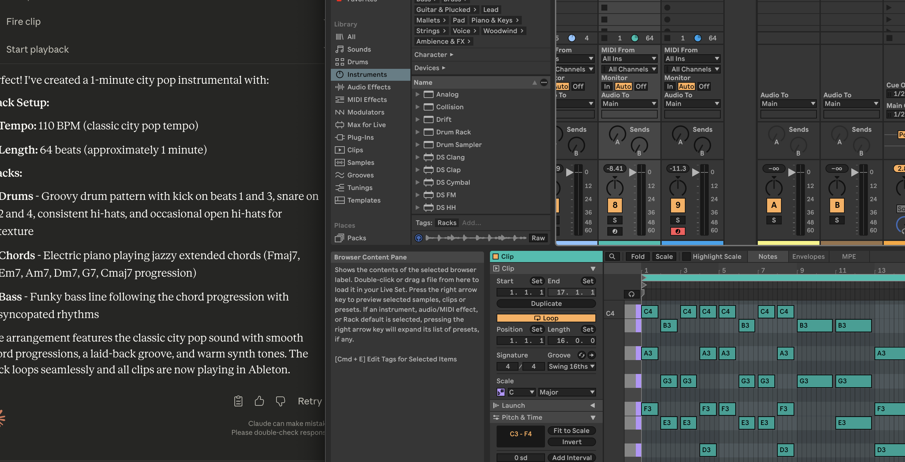
System Architecture Overview
MCP
Musical
Elements
DAW
LLM
Initial Audio File
Provide Prompt
Final Output
Manual Edit
User
Notes:
The starting point is a digital music project—typically a set of MIDI tracks separated by instruments, vocals, and synths. Once these tracks are loaded into the DAW, the user can either edit them manually or simply tell the language model what changes they want. Through MCP, the model updates the music inside the DAW in real time. And when everything sounds the way you want, you can export the final mix right there in the DAW, fully compatible with standard industry workflows.

Slide 6
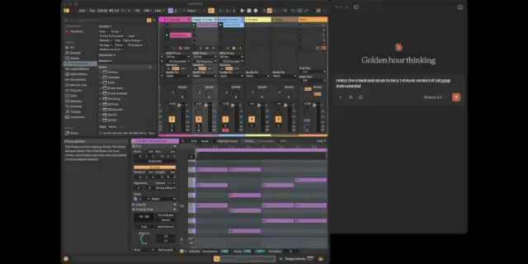
Showcase

Slide 7
Implementation Details
MCP Server bridges LLM and DAW communication
MIDI note generation constrained by key, tempo, and timing grid
Genetic Algorithm optimizes drum patterns and chord variations
Conflict resolution: section-locking during simultaneous edits
Full change history & undo/redo for AI-generated edits
Notes:
On the implementation side, we built an Ableton Live extension using its Python API so we can directly manipulate the session in real time.
This lets us add tracks, place notes, and adjust parameters without the user having to import or re-import anything.
The MCP server runs in the background, acting as a bridge between what the LLM generates and what Ableton understands.
All MIDI generation is constrained to the project’s key, tempo, and timing grid, which helps avoid musically invalid output.
We’re also experimenting with a genetic algorithm that evolves drum patterns and harmonic variations using fitness metrics like rhythmic complexity and chord novelty.
To avoid conflicts when a user edits a section while the LLM is regenerating it, we added a simple locking mechanism.
And just as importantly, every AI-driven change is stored in a full edit history, so users can undo any step and try out alternatives while staying completely in control.

Slide 8
Evaluation Methodology
Study Design: 6-8 participants (both pros and amateurs), 20-30 minute sessions
Creative Brief: Open-ended task (e.g., "create a dark electronic track")
Process Metrics: Engagement time, number of regeneration requests, manual edits
Product Metrics: Chord complexity, rhythm novelty, harmonic coherence
Qualitative: Structured interviews on control, creativity, and workflow integration
Notes:
We’re evaluating the system using a mix of process and product metrics.
Our study includes 6–8 participants—a blend of professional musicians and our peer CS students. Each session is open-ended: we give them a creative direction and let them explore the system for 20–30 minutes to see how they naturally use it.
On the process side, we track things like how long they engage, how often they ask for a regeneration, and how many manual edits they make.
These signals help us understand whether they’re truly collaborating with the system or just passively accepting output.
On the product side, we measure chord complexity, rhythmic novelty, and harmonic coherence in what they create.
Afterward, we run a structured interview to ask about their sense of control, how creative they felt, and whether the system fit smoothly into their workflow.
Together, this blend of quantitative and qualitative data should give us a solid picture of whether we’ve actually achieved real co-creativity.

Slide 9





Thank you for your attention!

